Slide 2
Disciples Women affirm the unity of the global church
Woman-to-Woman Worldwide (WWW) offers a life-transforming connection and learning experience.
WWW responds to the call for women of faith to experience solidarity with one another, to affirm the unity of the church in Jesus Christ and to join the common struggle for justice and peace in the world today.
Each year a delegation visits sisters in other countries to learn from them what it means to be a woman of faith in their context.
International, ecumenical and personal experiences encourage faithful women to see the world through new eyes and bring that perspective back to their congregation and community.

Slide 3
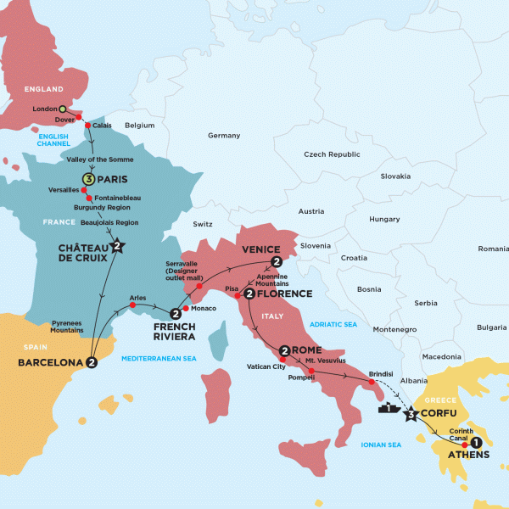
Italy – France - Greece

Slide 4
WWW 2014 Italy, France, Greece
Dates not yet set: possibly between October 6 - 20
Cost not yet calculated: currently estimated at $3,600 plus personal airfare to/from city of departure
Registration Form – Due by April 1
Registration Form will be posted next week
Communication of information will be transmitted by email; if applicant does not have email address can partner with close friend or relative who can pass along information from email
Date application received is a factor in selection but every effort is made to have a diverse delegation in geography/region, ethnicity, age, etc.
Participants are expected to share experiences with their congregation, region, and other groups in the United States and Canada when they return

Slide 5
WWW Guidelines
Candidates are required to read guidelines prior to applying -- available at www.DisciplesWomen.org
Candidates must meet ALL requirements of the WWW journey including physical requirements.
Physical:
Able to walk up three flights of stairs carrying your own luggage;
Able to walk a mile in 15 minutes without stopping;
Able to go without alcohol for two weeks;
Able to check pre-trip e-mails weekly, search the Web and print
materials (either personally do this or have the support system
to do so) – e-mail address is required and;
Ability to listen with brain as well as ears.

Slide 6
WWW Guidelines
Personality / Spiritual:
Flexibility (the day may not always go as planned);
Ability to put your wants aside for the good of the group; follow written and spoken directions; be on-time, every time; be without electronic technology 24 hours or longer; get along with those different from yourself; go outside of personal comfort zone to be a help to fellow participants; to accept others who may be having a bad day; to realize (this isn’t a vacation trip) you may not have all the comforts of home (hot water, flushing toilets, and daily showers); and you may not know the full extent of this until you arrive incountry— the potential for more “camping” than “luxury” hotel.
Willingness to share a room for two weeks with someone who may be very different from you in age, temperament, or background; to put personal wants and desires aside and to participate fully in all activities—journaling, devotions, etc.; to live out of one suitcase for two weeks

Slide 7
WWW Guidelines
Diversity:
Age
Ethnicity
Regional and Constituency
Life Situations

Slide 8
Dates and important notice
April 1 - Application is due.
April 15 - Notice of Acceptance to participants and regional staff.
May 15 - Deposit of $600 and 2 copies of pages 1 & 2 of Passport due.
June 15 – 1/3 of balance of the registration fee is due and deposit is non-refundable.
Cancellations after this point are subject to airfare and hotel cancellation penalties.
July 15 – 1/2 of remaining balance of the registration fee is due.
August 15 – the balance of the registration fee is due.
**Due to the necessity of spending funds well before journey begins, the balance must be paid by August 15 or we will need to remove you from the list of participants.**

Slide 9
Release Form
I hereby waive any and all claims for illness or injury which directly result from my participation in the Woman-to-Woman Worldwide experience to our scheduled countries for myself, heirs, administrator, executor and assigns against staff and sponsors of the Woman-to-Woman Worldwide program. I further state that I have read the online Candidate Guidelines, understand them, meet or exceed them, and agree to abide by them. I confirm that I am physically able to fully participate in this journey. I give permission to use my likeness and written word in any matter deemed necessary to advertise or promote the WWW program. I am aware that all reasonable basic precautions are taken by Woman-to-Woman Worldwide staff. I am responsible for reading provided materials.

Slide 10
Service Projects
Before and after journey participants, as well as the whole Church, are invited to contribute to and participate in service projects that directly serve the women of the countries to which WWW journeys
Helps to educate delegation prior to journey
Opportunity to support and empower women with whom relationships are built during journey

Slide 11
Oreon E. Scott Grant
To increase our capacity to include more young Disciples women (18-35) for the 2014 WWW journey by providing scholarships to support 4 young women to participate in the Woman to Woman Worldwide contextual learning.
To provide a learning experience that changes lives and will lend support to a new generation of mission-focused women in the life of the church.
**Provide $2,000 each to four women
between the ages of 18-35
to participate in 2014 WWW journey**

Slide 12
Italy – France - Greece

