Slide 2
Being with women when they are
inspired
moved
challenged
comforted
relieved
excited
motivated
educated
illuminated
Blessings

Slide 3
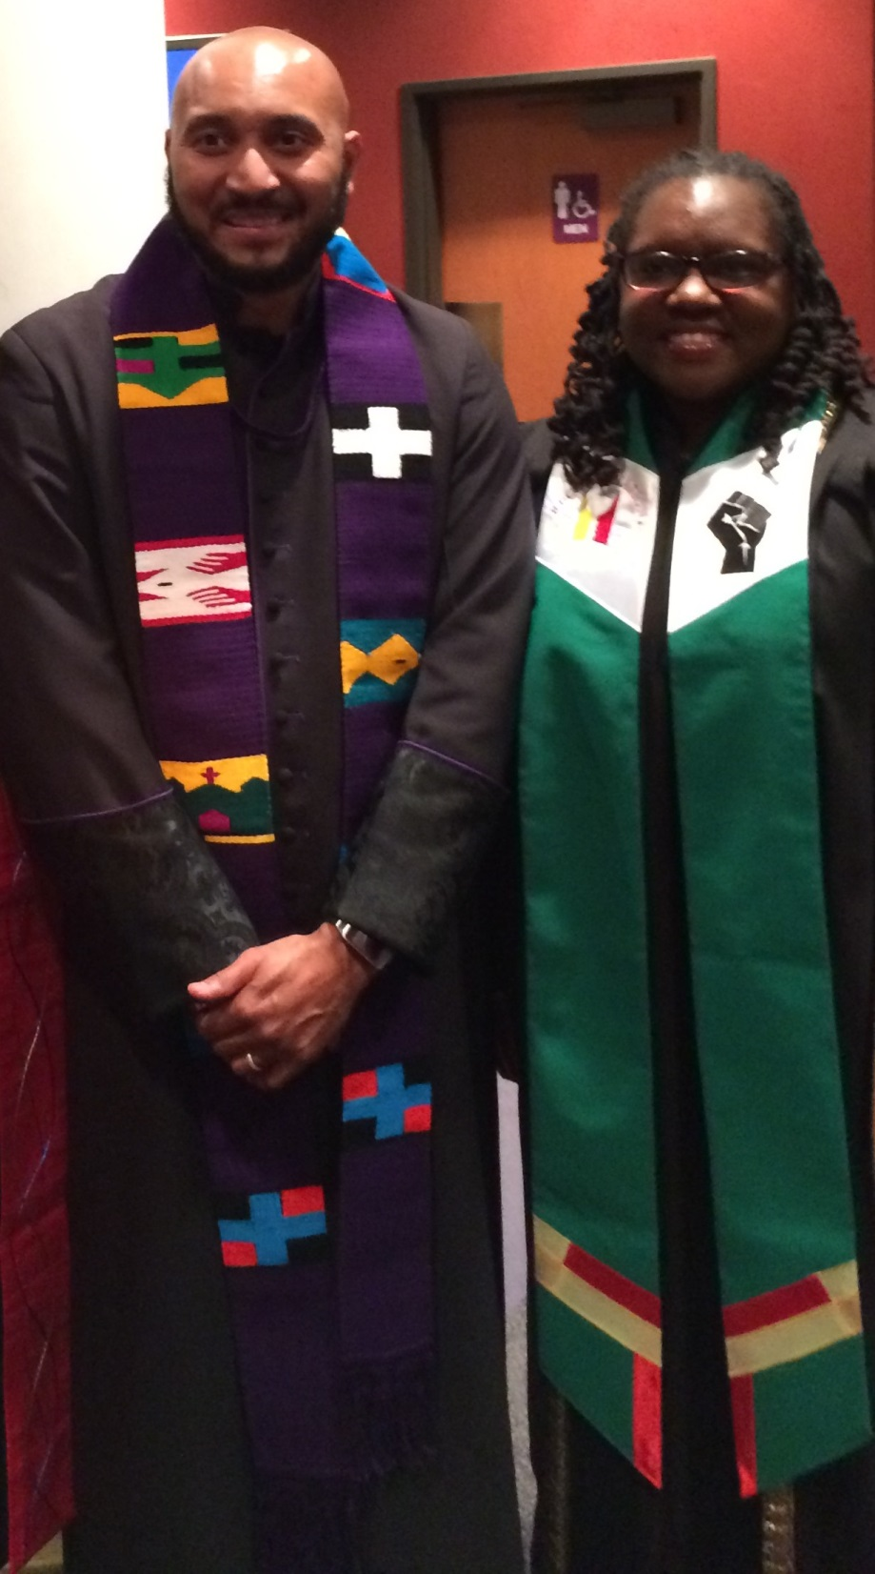
Called in June 2014
Ordination of the Reverend Chesla Nickelson
November 2014

Slide 4
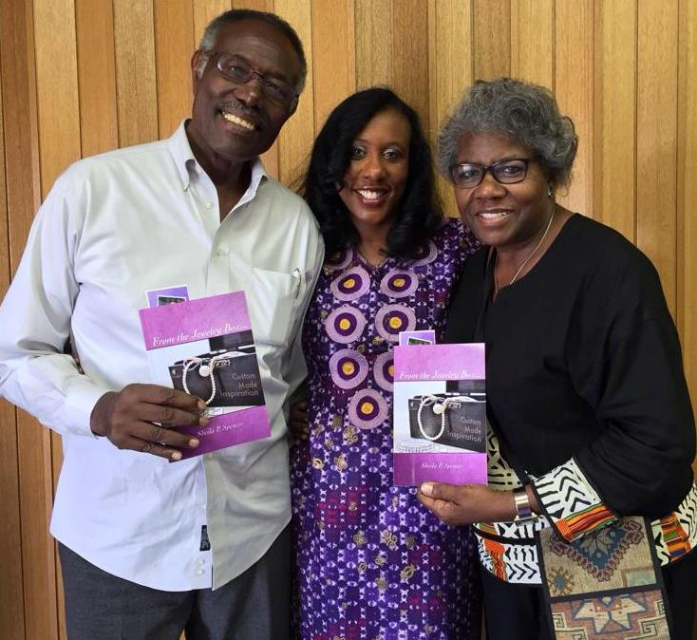
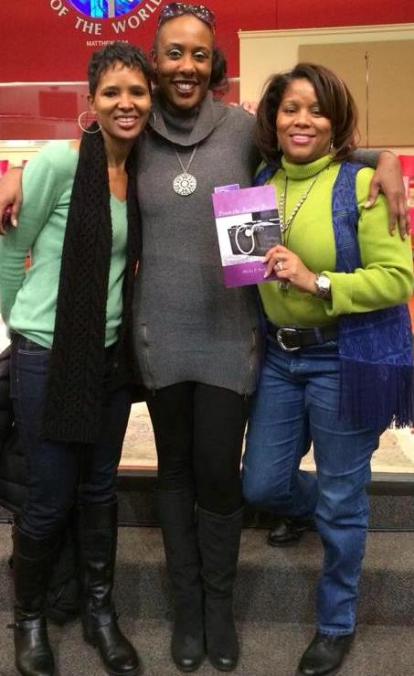
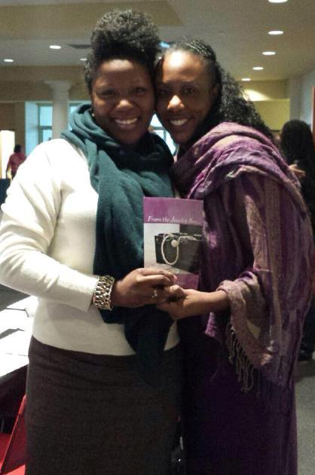
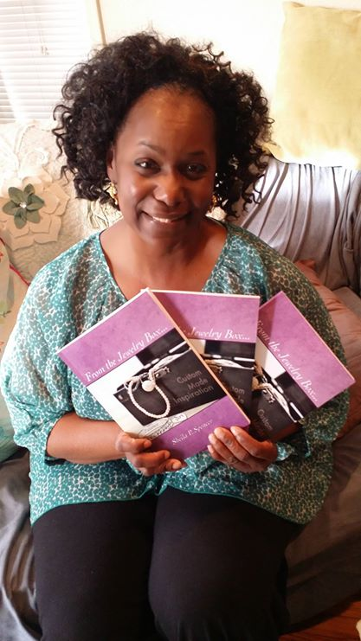
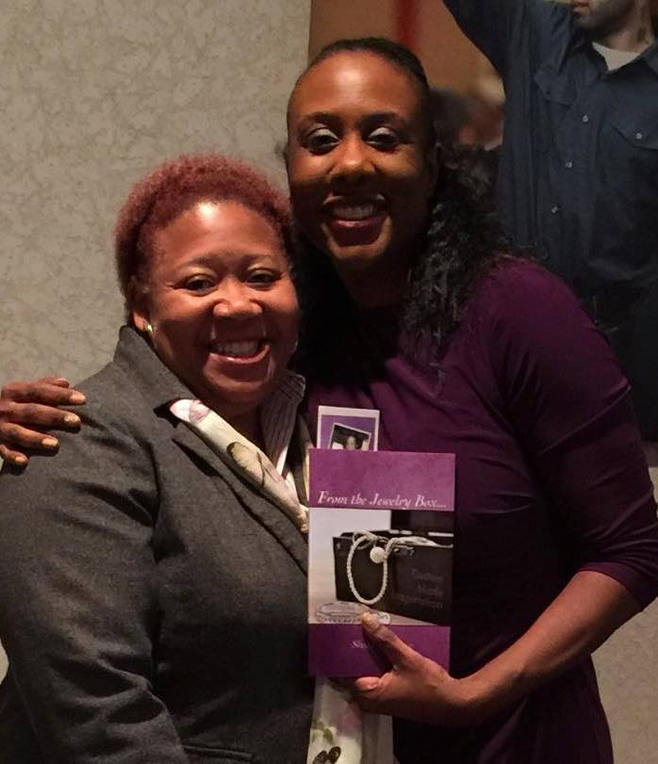
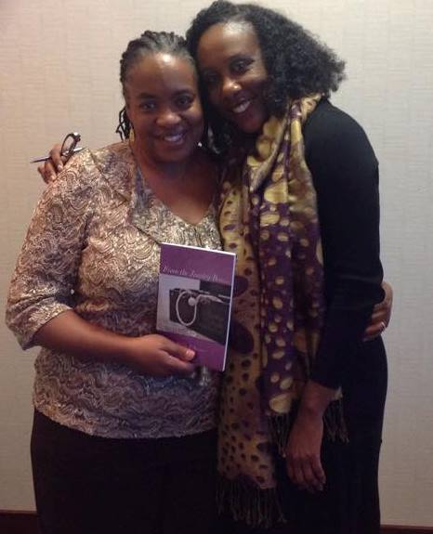
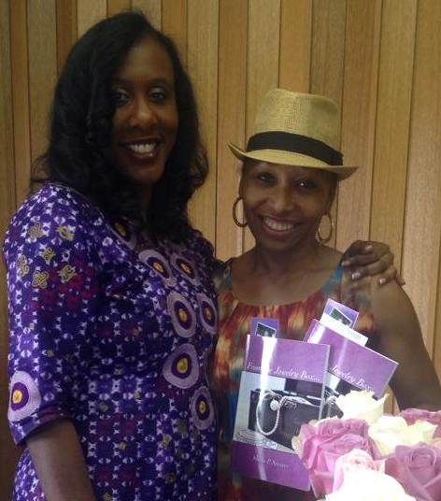
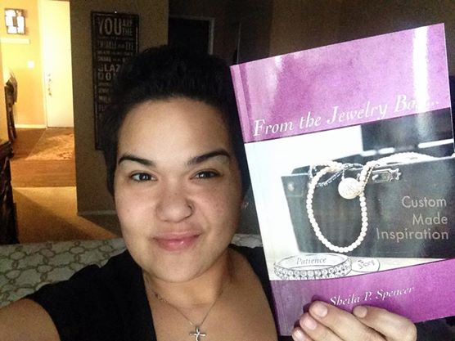
From the Jewelry Box…
by Sheila P. Spencer

Slide 5
THE VISION OF THE CHRISTIAN CHURCH (DISCIPLES OF CHRIST):
To be a faithful, growing church, that demonstrates true community, deep Christian spirituality and a passion for justice.

Slide 6
The Purpose of Disciples Women
As part of the Christian Church (Disciples of Christ), Disciples Women welcomes all to the table as Christ has welcomed us. The ministries of Disciples Women are part of the movement for wholeness in a fragmented world by:
Providing opportunities for spiritual growth, enrichment, education and creative ministries to enable women to develop a sense of personal responsibility for the whole mission of the church of Jesus Christ
Providing a channel through which women in the congregation and the regional Women’s Ministries in the United States and Canada may be joined in fellowship and find means for effective participation in the Christian Church (Disciples of Christ).

Slide 7
On the Move
We are Disciples Women
#DWSoar

Slide 8
Disciples Women Ministries
Worship for spiritual growth and renewed discipleship;
Bible Study for greater knowledge, understanding and service;
Issue Study for action and advocacy;
Mission Study for knowledge, understanding and acceptance of others;
Service / Action for hands-on/personal involvement;
Fellowship / Networking for building the faith community with other women;
Leadership Training for service to God in the church, the community and the world;
Stewardship of time, talent and resources for the mission of the church.

Slide 9
Disciples women Giving
$811,175 in 2014;
$885,101 in 2013;
$954, 997 in 2012;
$1,067,288 in 2011
Support Disciples ministry and mission through
33 regions, seven seminaries and foundation houses, 17 colleges and universities, ecumenical partnerships and unity connections, global ministries in 52 countries, home missions, stewardship and funding for the church, ministerial relief, communication, ministries of justice and compassion
Reduced giving is affecting what and how we do women’s ministries

Slide 10
Funding
Support to InterRegional Gatherings
WWOW had amazing diversity of age and ethnicity – women who were first time participants are already leading other ministries
Opportunities to network, train, and learn
Build relationships – potential for more shared ministry/resources
Staff travel to general and regional assemblies, meetings, and retreats
Ministry of presence, leadership, education on women’s issues/ministries
Support Disciples Women function as ‘general ministry’
Participation in Justice Table ministry

Slide 11
Funding
Staff
Search and Call – program director; diverse team to do thorough search
Salaries and benefits
Executive Committee – Meetings and travel
DWLC – Networking and education of regional staff and presidents annually
Resources – Just Women, general programs, newsletters, etc.
General Assembly – opportunities for education and network on the work of Disciples Women
Luncheon to share information and reunite

Slide 12
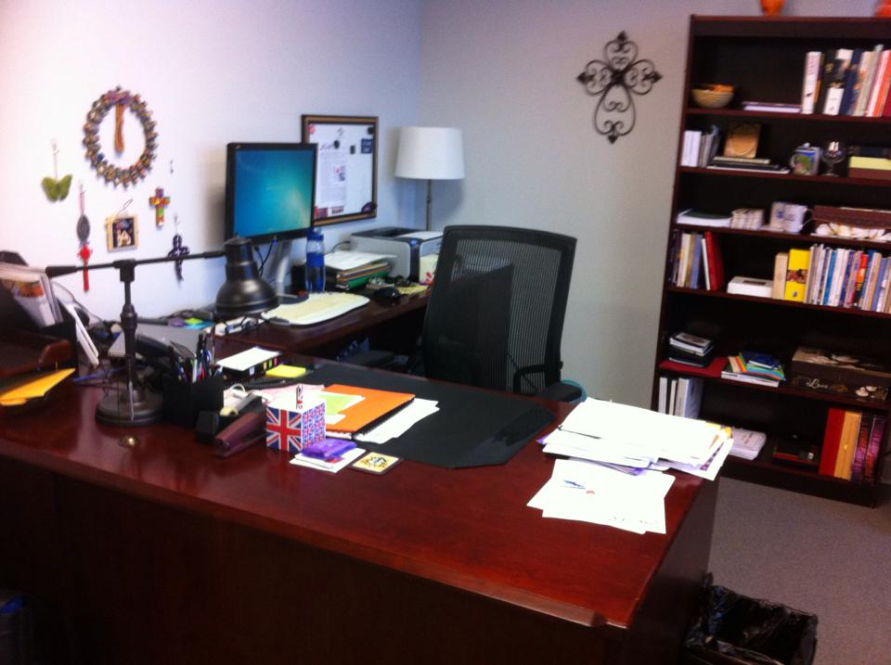
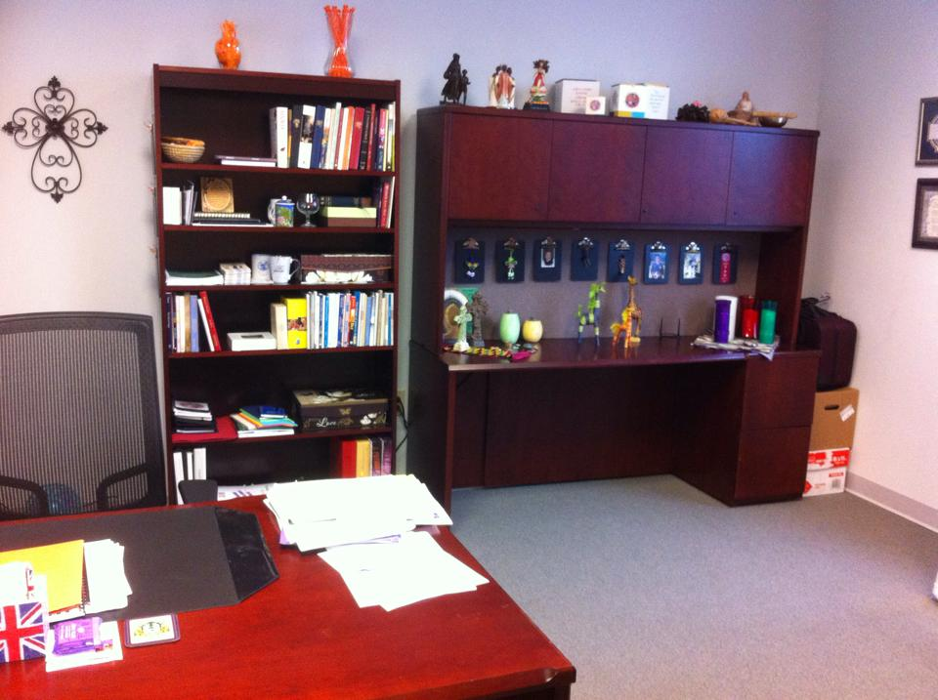
Funding
Quadrennial Assembly
Costs not covered by QA budget
Facilitation/Administration
DWEF
W2WW
Office Space
Healthier conditions
More interaction between ministries

Slide 13
Blessing Box Giving
 | Blessing Box Offering | Portion to Disciples Women
2011 | $170,089 | $85,044
2012 | $166,311 | $83,155
2013 | $141,278 | $70,639
2014 | $142,873* | $71,436*
Includes *QA offering

Slide 14
Region | 2011 | 2012 | 2013 | 2014 | Increase 2013-2014
Alabama/NW Florida | 2,914 | 2,591 | 1,830 | 1,338 | -492
Arizona | 3,593 | 1,792 | 123 | 2,302 | 2,179
California N./Nevada | 1,084 | 888 | 1,157 | 1,011 | -146
Canada | 863 | 1,042 | 476 | 780 | 304
Capital Area | 280 | 396 | 485 | 361 | -124
Central Rocky Mountain | 1,628 | 2,153 | 1,282 | 1,796 | 514
Florida | 6,048 | 4,682 | 3,683 | 3,952 | 269
Georgia | 8,206 | 7,650 | 8,782 | 7,627 | -1,155
Greater Kansas City | 804 | 10,202 | 3,487 | 3,052 | -435
Great River | 6,356 | 6,359 | 5,851 | 5,107 | -744
Idaho, South | 914 | 1,139 | 1,375 |  | -1,375
Illinois/Wisconsin | 9,954 | 8,537 | 8,076 | 8,010 | -66
Indiana | 16,159 | 15,444 | 10,011 | 9,255 | -756
Kansas | 7,248 | 7,388 | 7,111 | 7,787 | 676
Kentucky | 14,013 | 12,363 | 10,387 | 10,465 | 78
Michigan | 2,035 | 2,040 | 1,590 | 510 | -1,080
Mid-America | 8,606 | 7,576 | 7,964 | 6,068 | -1,896
Montana | 214 | 575 | 349 | 936 | 587
Nebraska | 2,672 | 2,533 | 2,411 | 2,792 | 381
North Carolina | 16,423 | 18,492 | 15,220 | 15,408 | 188
Northeastern | 851 | 414 | 389 | 279 | -110
Northwest | 1,283 | 587 | 730 | 845 | 115
Ohio | 2,631 | 1,682 | 1,943 | 2,541 | 598
Oklahoma | 6,331 | 6,830 | 4,771 | 4,124 | -647
Oregon | 1,475 | 1,730 | 1,392 | 1,141 | -251
Pacific Southwest | 2,467 | 2,367 | 2,563 | 1,556 | -1,007
Pennsylvania | 3,773 | 1,934 | 4,004 | 3,659 | -345
South Carolina | 180 | 235 | 25 | 597 | 572
Southwest | 18,776 | 15,498 | 13,997 | 11,603 | -2,394
Tennessee | 3,611 | 3,054 | 3,389 | 2,405 | -984
Upper Midwest | 3,992 | 2,244 | 1,604 | 2,590 | 986
Virginia | 12,459 | 13,197 | 12,642 | 10,228 | -2,414
West Virginia | 2,201 | 2,320 | 1,898 | 2,489 | 591
General Miscellaneous | 45 | 377 | 281 | 10,259 | 9,978

Slide 15
Blessing Box Invitation from QA
Count your many blessings, name them one by one
Count your many blessings, see what God has done
At QA, we were invited to imagine what ministry could be done in the whole church mission and in women’s ministries if the women of each congregation set a goal of $1,000 for 2015.
and,
Imagine the statement that would be made about the importance of women’s ministries

Slide 16
Just Women
Just Women magazine is a Disciples Women publication developed by and for Disciples women as a resource providing theme articles inspired by scripture, multi-generational conversations, reflections on healthy living and faith, ecumenical Bible study, group study guides, and more.
Just Women magazine is the official study resource to accompany the Woman-to-Woman Worldwide focus country.

Slide 17
Leadership Training
The Leader Apprentice Program (LAP) focuses on equipping Disciples women of color to serve in their home congregations and in regional and general arenas of church life.
The annual Disciples Women Leadership Council (previously known as Staff Fellowship) meetings include Disciples Women staff persons from each region, Disciples Women presidents of regions without a staff person, and constituency group leaders to ensure the voices of all Disciples women are heard. These meetings provide opportunities for renewal, networking, professional development, enrichment and support of the members, updates on current resources and objectives, and an advisory and communication channel to share in advocacy for women.
Inter-Regional Leadership Training takes place every four years in each of the 5 Inter-regional groups. The training provides tools and information to strengthen established leaders while encouraging new leadership among newly involved women and young women.

Slide 18
News from 2014
Partnered with the Center for Public Witness to sponsor an additional Disciples Peace Fellowship intern
Cara McKinney served at QA with Civil Rights Celebration; also served with NBA in Xplor program
Promoted advocacy, women, children, poverty
Networked women with camp youth
Freight Software: Purchased a package of software that would more equitably calculate shipping costs when Bible studies, logo items, QA materials, etc. are ordered

Slide 19
Social Media Updates
www.DisciplesWomen.org
www.Facebook.com/discipleswomen
www.Discipleswomen.wordpress.com
USA, Canada, UK, India, Indonesia, China, Norway, Australia, France, Chile, Switzerland, Belgium, Italy, Philippines, Viet Nam, South Africa, New Zealand, and more
Twitter @DisciplesWomen
www.Facebook.com/JustWomenDW
www.YouTube.com/DisciplesWomenDOC

Slide 20
Future Dates for meetings
January 20-24, 2016
January 25-29, 2017
January 24-28, 2018

Slide 21
Travel Pool Account
 | December 31, 2014 | December 31, 2013 | December 31, 2012 | December 31, 2011
 | Actual | Actual | Actual | Actual
Beginning Balance, January 1 | 8,011.07 | 13,798.21 | 17,640.26 | 20,917.40
Income
IDWM | 12,500.00 | 12,500.00 | 12,500.00 | 12,500.00
Disciples Mission Fund | 11,000.00 | 11,000.00 | 11,000.00 | 11,000.00
Travel Pool dues | 12,542.65 | 13,009.04 | 13,088.50 | 6,432.74
Total Income | 36,042.65 | 36,509.04 | 36,588.50 | 29,932.74
Expenses
Travel | 14,815.55 | 19,060.69 | 14,853.91 | 10,626.30
Hotel Rooms | 15,130.44 | 12,770.44 | 14,507.79 | 10,930.61
Meals | 10,291.70 | 8,580.00 | 10,512.81 | 10,273.28
Office supplies and printing | 45.89 | 1,885.05 | 556.04 | 1,379.69
Total Expenses | 40,283.58 | 42,296.18 | 40,430.55 | 33,209.88
Income over Expenses | -4,240.93 | -5,787.14 | -3,842.05 | -3,277.14
Ending Balance, December 31, | 3,770.14 | 8,011.07 | 13,798.21 | 17,640.26

Slide 22
DWLC Prayer List
02/02/15 | Alabama-NW Florida | Katie Wallace- Davis, Cindy Prince
02/09/15 | Arizona | Carol Friesen, Suzanne Delap
02/16/15 | California North and Nevada NW | Paula Bishop Pociecha, Denise Turner, Renae Earl
02/23/15 | Canada | Janet Fountain, Sarah Himaya, Awit Marcelino
03/02/15 | Capital Area | Kay Slonaker
03/09/15 | Central Rocky Mountain and SE Idaho | Lenna Fajerman
03/16/15 | Florida | Tracey Smithson
03/23/15 | Georgia | Betty Brewer-Calvert, Kathy Mason
03/30/15 | Great River Region | Wendy Paquette, Nearline Anderson
04/06/15 | Illinois-Wisconsin | Christal Williams, Vickie Nevius
04/13/15 | Indiana | Cheryl Cloar, Debbie Shephard
04/20/15 | Kansas | Barbara Runge, Pam Norstrom
04/27/15 | Kansas City | Karen Yount, Ginny Bottrell
05/04/15 | Kentucky | Linda Jones, Jamie Goodlet
05/11/15 | Michigan | Brenda Etheridge, Sarah Beth Simonds
05/18/15 | Mid-America | Donna Beaderstadt, Wanda Hedenberg
05/25/15 | Montana | Jean Muir, LeAnn Budeski
06/01/15 | Nebraska | Teresa Olberding, Judy McCalla
06/08/15 | North Carolina | Valerie Melvin, Lisa Hardee Belue
06/15/15 | Northeastern Area | Nontrell Taylor, Claudette Brown
06/22/15 | Northwest | Sandra Messick
06/29/15 | Ohio | Gena Stone-Phillips, Penny Phipps
07/06/15 | Oklahoma | Cathy Clark
07/13/15 | Oregon and SW Idaho | Cathy Myers Wirt
07/20/15 | Pacific Southwest | Susan Gonzales Dewey, Pat Messenger, Carol Warsaw
07/27/15 | Pennsylvania | Patty Hanes
08/03/15 | South Carolina | Gloria Gilliard, Frankie Walters
08/10/15 | Southwest | Tera Daniels
08/17/15 | Tennessee | Virzola Law, Marena McDonald
08/24/15 | Upper Midwest | Wende Bristow Barrett
08/31/15 | Virginia | Donna Webster, Kathy Umberger Witt
09/07/15 | West Virginia | Mary Uhl, Judy Church
09/14/15 | National Convocation | Wanona Redd, Pernella Shortie, LaShaundra McCarty
09/21/15 | National Hispanic & Bilingual Fellowship | Guillermina Peralez, Soriliz Rodriquez
09/28/15 | Regional Hispanic Presidents | Marcela Gutierrez, Rossy Castillo Riccart, Annie Rodriguez, Tanya Lopez, Milca Rivera, Maria Martinez
10/05/15 | North American Pacific/Asian Disciples | Soo Yun, Ely Obilo
10/12/15 | Piedmont District Convention | Deborah Clark
10/19/15 | Texas Christian Missionary Fellowship | Sally Green
10/26/15 | Church of Christ (DOC) | Claudia Griffin Pearson
11/02/15 | Mississippi Christian Missionary Fellowship | Ruby Howard
11/09/15 | Kentucky Chrisian Missionary Fellowship | Deborah Garr
11/16/15 | Haitian Congregations | Martine Saint-Vil
11/23/15 | Former ICWF/IDWM Officers
11/30/15 | Former Disciples Women Staff
12/07/15 | Current ICWF/IDWM Officers
12/14/15 | Disciples Women Staff

Slide 23
DWLC meetings
Last year agreed that we would continue to meet with either staff person or president of each region
Each region could send a maximum of 2 representatives: one being funded through common travel fund, the second one at the expense of the region
Would love to have more women trained and networking but have to be economical in venue selection…keeping it small
DWLC has fewer regional staff than four years ago
Regions are changing shape and size
Funding is still diminishing
DWLC is the best vehicle we currently have for sharing the news about resources, networking, sharing best practices and two way communication
DWLC asked for continued support for inter-regional gatherings every four years: reach larger group of leaders and potential leaders with information
Staff Concerns

Slide 24
Inter-regional Schedule
WESTERN (WWOW) Meets in ‘17 | NORTHEAST (NIRF) Meets in ‘15 October 9-11, 2015 | SOUTHEASTERN (SERF) Meets in ‘16 | HEARTLAND Meets in ‘17 | ROSES Meets in ‘15
ARIZONA Carol Friesen | CANADA Sarah Himaya - Central Janet Fountain - East Awit Marcelino – West | ALABAMA/NW FL Katie Wallace-Davis | GREATER KANSAS CITY Karen Yount | GREAT RIVER Wendy Paquette Nearline Anderson (President)
CA.NO./NV NW Paula Bishop Pociecha | CAPITAL AREA Kay Slonaker | FLORIDA Tracy Smithson (President) | ILLINOIS/WISCONSIN Christal Willliams | OKLAHOMA Cathy Clark (President)
CENTRAL ROCKY MTN. Lenna Fajerman (President) | MICHIGAN Sarah Simonds (President) | GEORGIA Betty Brewer-Calvert | INDIANA Cheryl Cloar | SOUTHWEST Tera Daniels (President)
MONTANA Jean Muir | NORTHEAST Nontrell Taylor | KENTUCKY Linda Jones | KANSAS Barb Runge | SOUTHWEST CONVENCION Maria Martinez
NORTHWEST Sandra Messick (Reg. Min.) | OHIO Gena Stone-Phillips Penny Phipps | NORTH CAROLINA Valerie Melvin | MID-AMERICA Wanda Hedenberg (President) | MISSISSIPPI CHRISTIAN MISSIONARY CONVENTON Ruby Howard
OREGON/SW Idaho Cathy Myers Wirt | PENNSYLVANIA Patty Hanes (President) | SOUTH CAROLINA Gloria Gilliard | NEBRASKA Teresa Olberding | TEXAS CHRISTIAN MISSIONARY FELLOWSHIP Sally Green
PACIFIC SOUTHWEST Susan Gonzales Dewey | WEST VIRGINIA Mary Uhl | TENNESSEE Julia Keith | UPPER MIDWEST Wende Bristow Barrett
PACIFIC CONVENCION Tanya Lopez plus Colorado Hispanic representation Arizona Hispanic – Marcela Gutierrez | NORTHEAST CONVENCION Annie Rodriguez Ohio Hispanic representation | VIRGINIA Donna Webster | MIDWEST CONVENCION (without Ohio & Colorado) Rossy Castillo Riccart
WEST COAST NAPAD Ely Obilo | CHURCH OF CHRIST (DOC) (Washington DC & Norfolk VA) Claudia Griffin Pearson | SOUTHEAST CONVENCION Milca Rivera | MIDWEST NAPAD Soo Yun
 | HAITIAN CONGREGATIONS Martine Saint-Vil | KENTUCKY MISSIONARY CONVENTION Deborah Garr, KY
 |  | PIEDMONT MISSIONARY CONVENTION Deborah Clark

Slide 25
Inter-Regional Model
PURPOSE: To develop leadership skills for women serving on Regional Disciples Women Cabinets / Commissions/Constituencies and women identified with leadership potential to provide the knowledge and resources which will enable persons to enter into leadership and fulfill their responsibilities with increased effectiveness.
TIME AND PLACE: Held every four years over a Friday evening through Sunday noon. The staff of the interregional group determine which region will host the event.

Slide 26
Woman-to-Woman Worldwide
Life-transforming connection and learning experience.
W2WW responds to the call for women of faith to experience solidarity with one another, to affirm the unity of the church in Jesus Christ and to join the common struggle for justice and peace in the world today.
Each year a delegation visits sisters in other countries to learn from them what it means to be a woman of faith in their context.
International, ecumenical and personal experiences encourage faithful women to see the world through new eyes and bring that perspective back to their congregation and community.

Slide 27
Social Action Emphasis

Slide 28
General Assembly 2015
Columbus, Ohio
Luncheon on Wednesday, July 22
Disciples Women included with General Ministries – stage report
Theme is SOAR!
We are accumulating pictures of Disciples Women on the Move #DWSoar
We are asking you to post pictures of Disciples Women on the move on DW Facebook page, your page, or anywhere on social media with the #DWSoar. We will be celebrating these women on the move at the GA luncheon. There will be prizes awarded randomly to some of the people who post to DW or post on their own page a picture with the hashtag.

Slide 29
SOAR!
The General Assembly in 2015 will be focused around the
theme of SOAR! Disciples Women invite you to SOAR
with them above the pain and struggle that is part of the
world we live in…rising above with God’s help.
Reflecting the work of Disciples Women’s Ministries,
we will be accumulating peace cranes.
There is a Japanese legend that says if a person folds 1,000 cranes they will get their wish. This inspired us to think about what we do when we have a deep need. Our intent is to gather 1,000 cranes with 1,000 prayers written on them by the end of GA 2015. When we have achieved this goal we will join together in prayer and offer all these concerns to God. Knowing that God will already be answering these accumulated prayers, we will also offer thanks for what God has already done and is already doing.
Between now and GA as Disciples Women staff journeys to be with people in many contexts, we will be accepting cranes to be brought back with us. (Or, you can send them to the office.) At GA, there will be cranes already made and waiting for prayers as well as paper to make cranes at the Disciples Women booth. We look forward to adding your prayer and your crane to the flock so together we will pray for the concerns of our sisters and brothers knowing that God hears us. Together we will SOAR into wholeness!

Slide 30
What is a Disciples Woman? And why do I care?
So what?
What makes Disciples Women different from other organizations/groups?
What are we doing to help women build better relationships with God as well as with one another?

