Slide 1
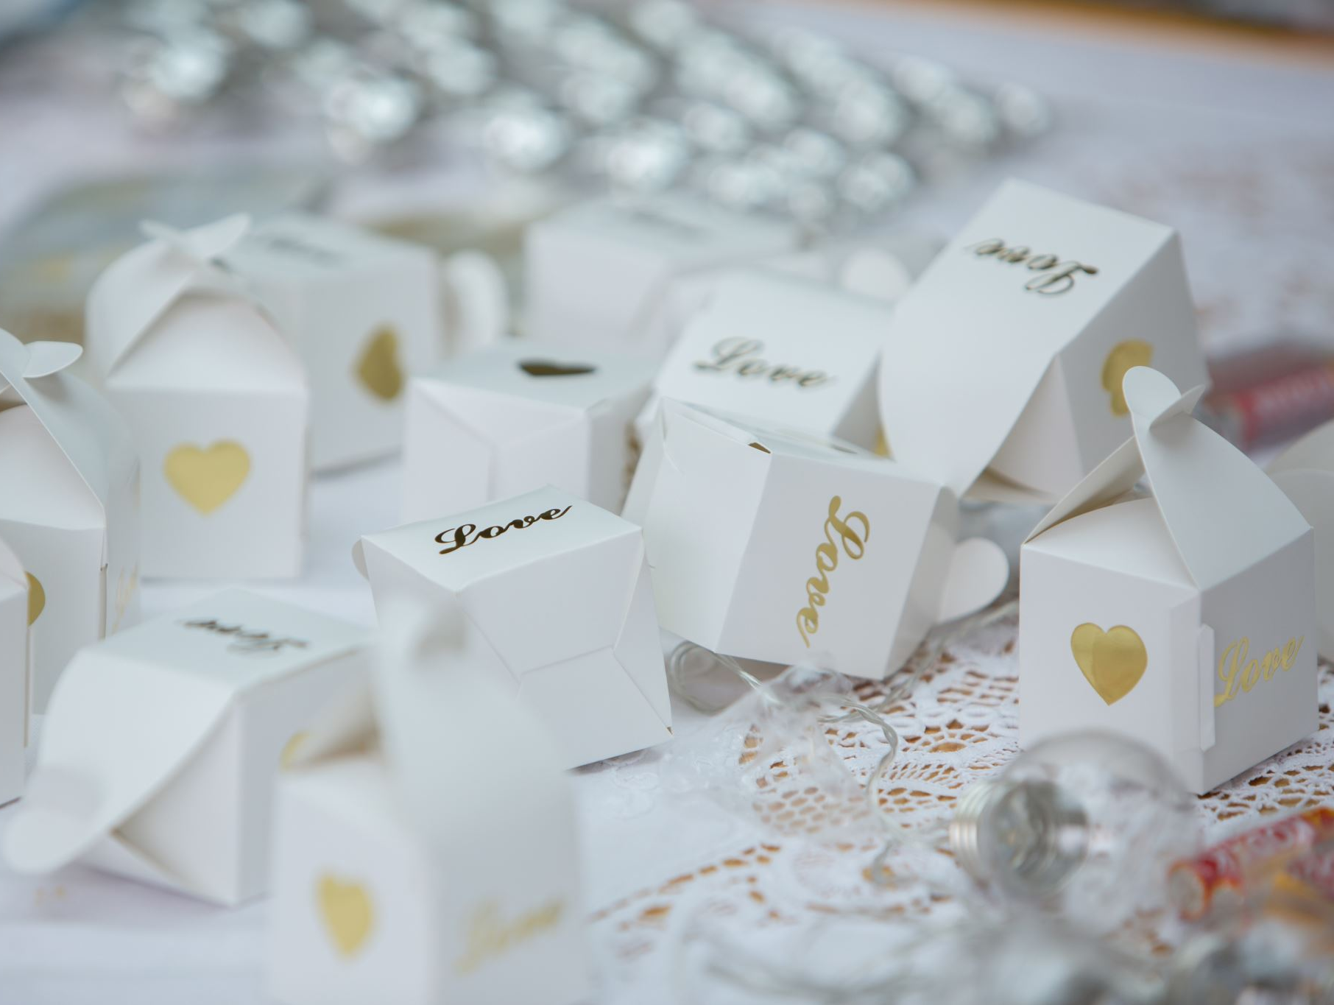

The Blessing Box
A Spiritual Discipline of Gratitude and Mission for Women

Slide 2

A Daily Practice of Gratitude
The Blessing Box is a spiritual discipline for women.
Pause each day and ask:
How has God blessed you today?

Slide 3
A Legacy of Faithful Women
Mite Box
Love Gifts
Thank Offering Box
Blessing Box
Women have practiced gratitude for generations.

Slide 4
Making a Difference
$4,085,984 given since 1999
$1,286,614 for women’s ministries
50% supports the whole church
50% supports Disciples Women

Slide 5
Your Gifts Support
• Leadership training
• Women’s retreats
• Just Women magazine
• New ministries
• Social advocacy

Slide 6
Get Started
1. Order a Blessing Box
1
2. Place it in your home
2
3. Add daily offerings
3
Let gratitude grow daily.

Slide 7
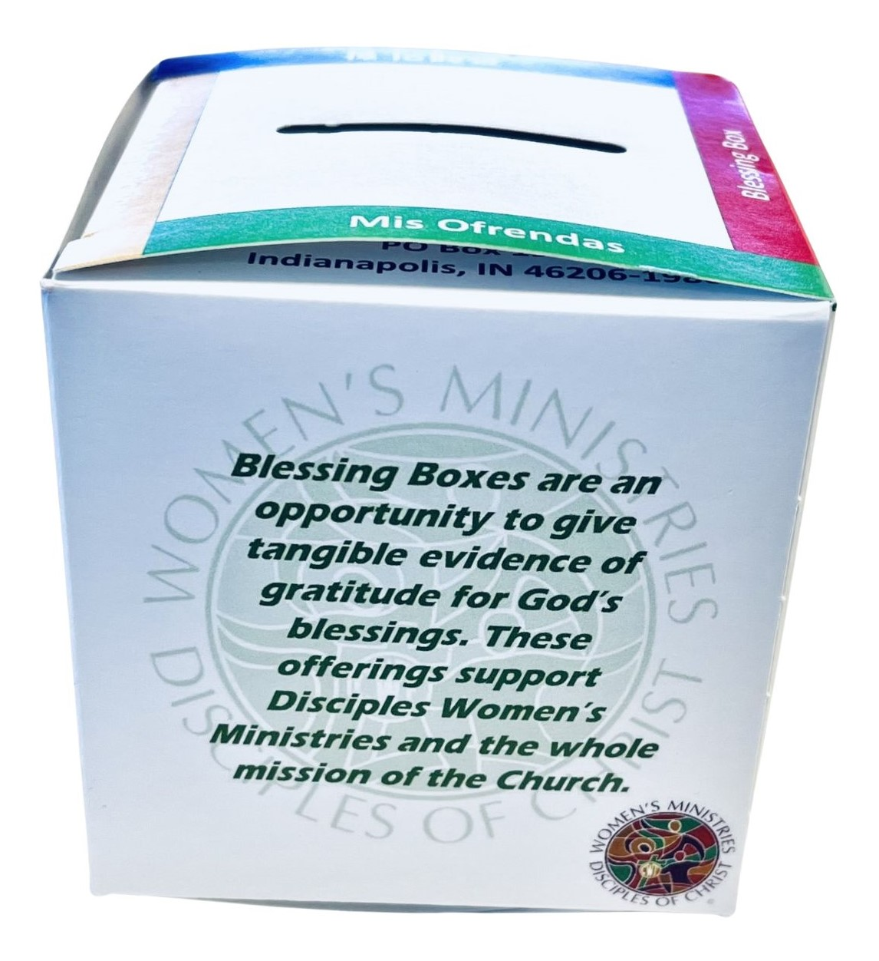
Your Blessing Matters
Your daily gratitude becomes a witness.
Your small gifts become mission.
Together, women of faith make a difference.

